Slide 1
Section 4.4
Quadratic Models; Building Quadratic Functions From Data
Copyright © 2012 Pearson Education, Inc. Publishing as Prentice Hall.

Slide 2
Copyright © 2012 Pearson Education, Inc. Publishing as Prentice Hall.

Slide 3

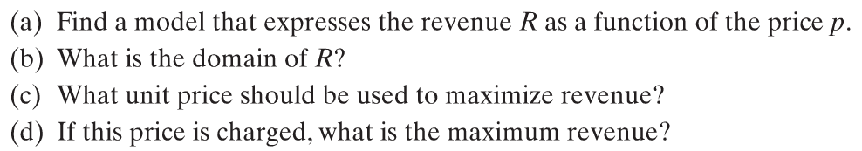




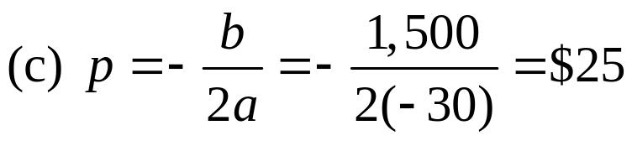
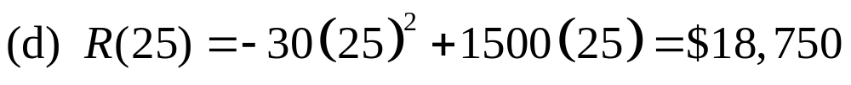
The marketing department at Widgets Inc. found that, when certain widgets are sold at a price of p dollars per unit, the number x of widgets sold is given by the demand equation
x = 1,500 – 30p
Copyright © 2012 Pearson Education, Inc. Publishing as Prentice Hall.

Slide 4
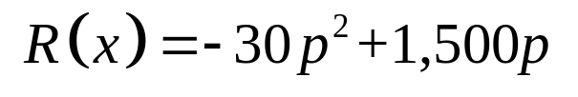
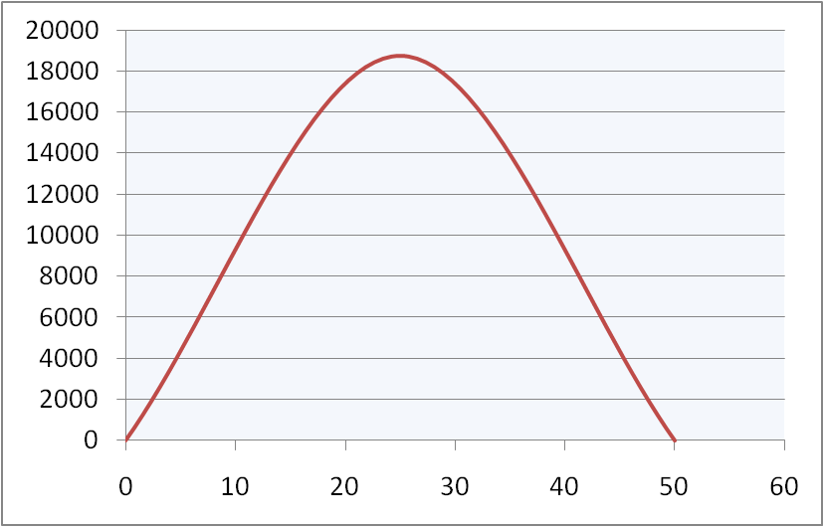
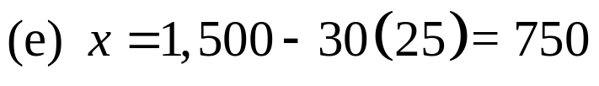



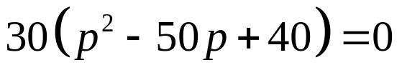


The marketing department at Widgets Inc. found that, when certain widgets are sold at a price of p dollars per unit, the number x of widgets sold is given by the demand equation x = 1,500 – 30p
How many units are sold at this price?
Graph R.
What price should Widgets Inc. charge to collect at least $12,000 in revenue?
So the company should charge between $10 and $40 to earn at least $12,000 in revenue.
Copyright © 2012 Pearson Education, Inc. Publishing as Prentice Hall.

Slide 5
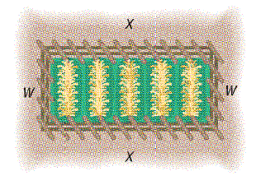
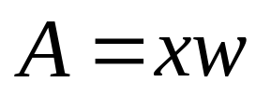
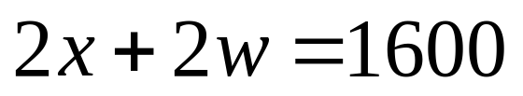
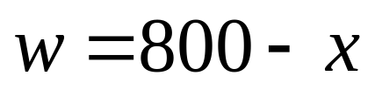
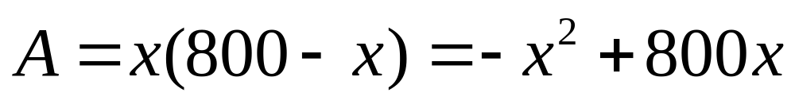
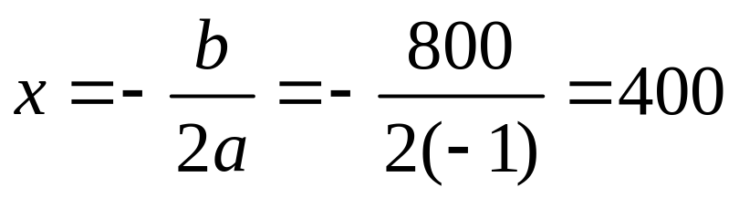

A farmer has 1600 yards of fence to enclose a rectangular field. What are the dimensions of the rectangle that encloses the most area?
The farmer should make the rectangle 400 yards by 400 yards to enclose the most area.
Copyright © 2012 Pearson Education, Inc. Publishing as Prentice Hall.

Slide 6
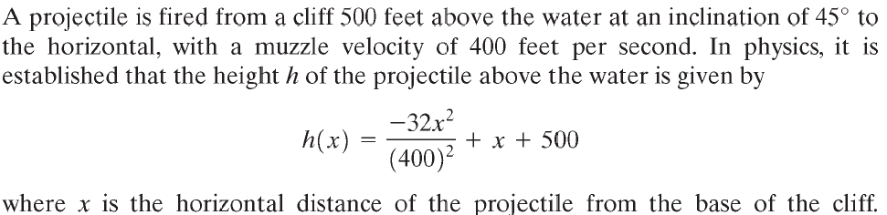
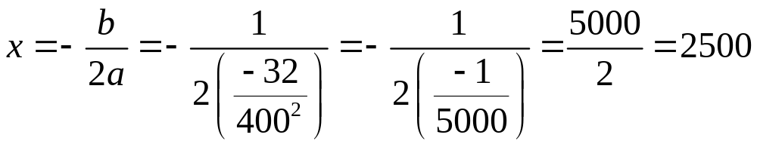
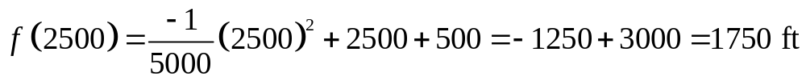
Find the maximum height of the projectile.
Copyright © 2012 Pearson Education, Inc. Publishing as Prentice Hall.

Slide 7
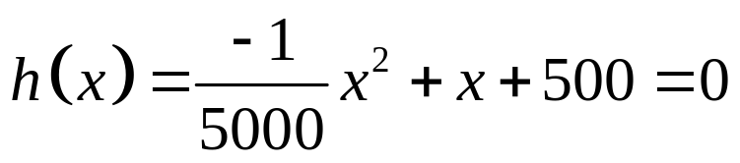
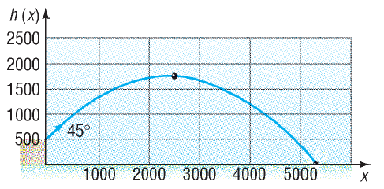
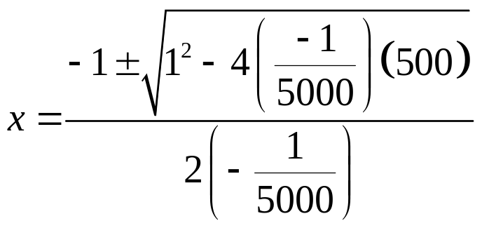

(b) How far from the base of the cliff will the projectile strike the water?
Solution cannot be negative so the projectile will hit the water about 5458 feet from the base of the cliff.

Slide 8
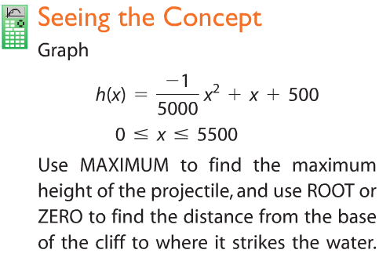
Copyright © 2012 Pearson Education, Inc. Publishing as Prentice Hall.

Slide 9

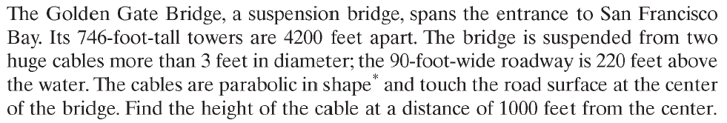
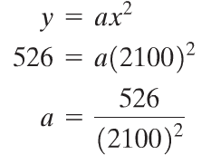
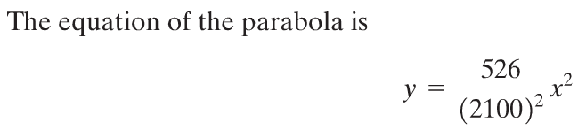

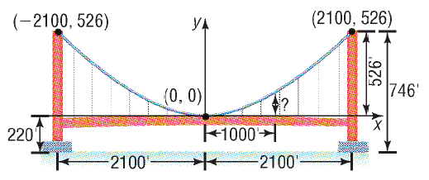

Slide 10

Copyright © 2012 Pearson Education, Inc. Publishing as Prentice Hall.

Slide 11
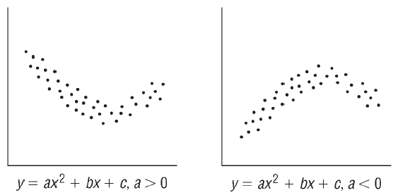
Copyright © 2012 Pearson Education, Inc. Publishing as Prentice Hall.

Slide 12
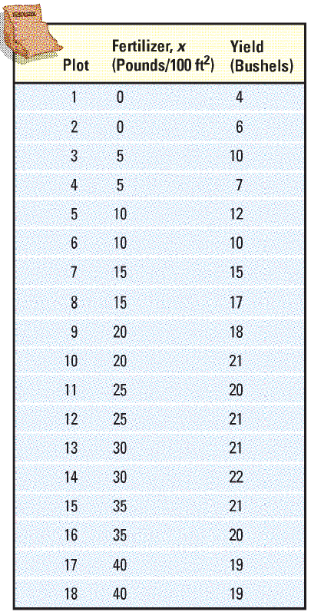

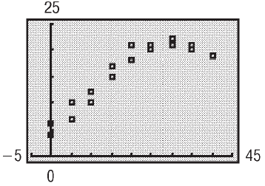
Table 3
Copyright © 2012 Pearson Education, Inc. Publishing as Prentice Hall.

Slide 13
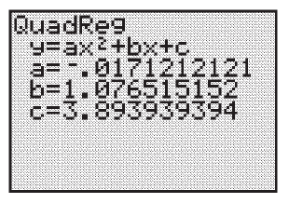
Table 3
Copyright © 2012 Pearson Education, Inc. Publishing as Prentice Hall.

Slide 14

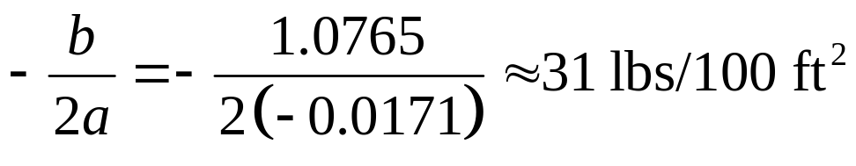
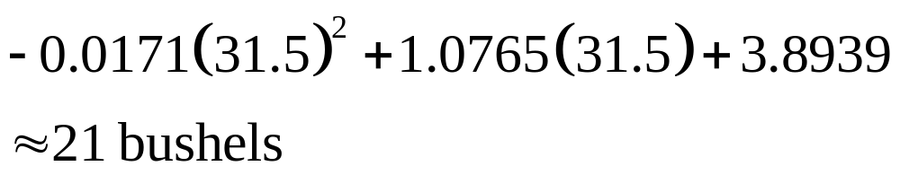
Table 3
Copyright © 2012 Pearson Education, Inc. Publishing as Prentice Hall.

Slide 15
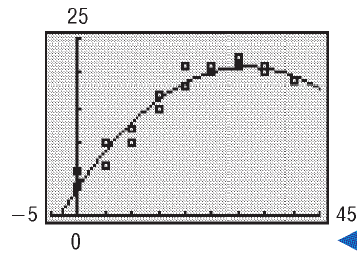
Table 3
Copyright © 2012 Pearson Education, Inc. Publishing as Prentice Hall.

